Slide 1
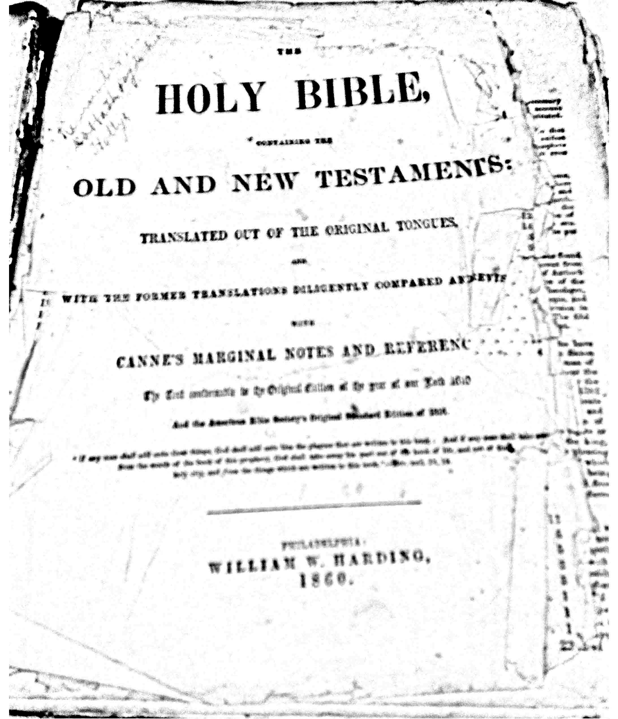
Family Bible 1

Slide 2
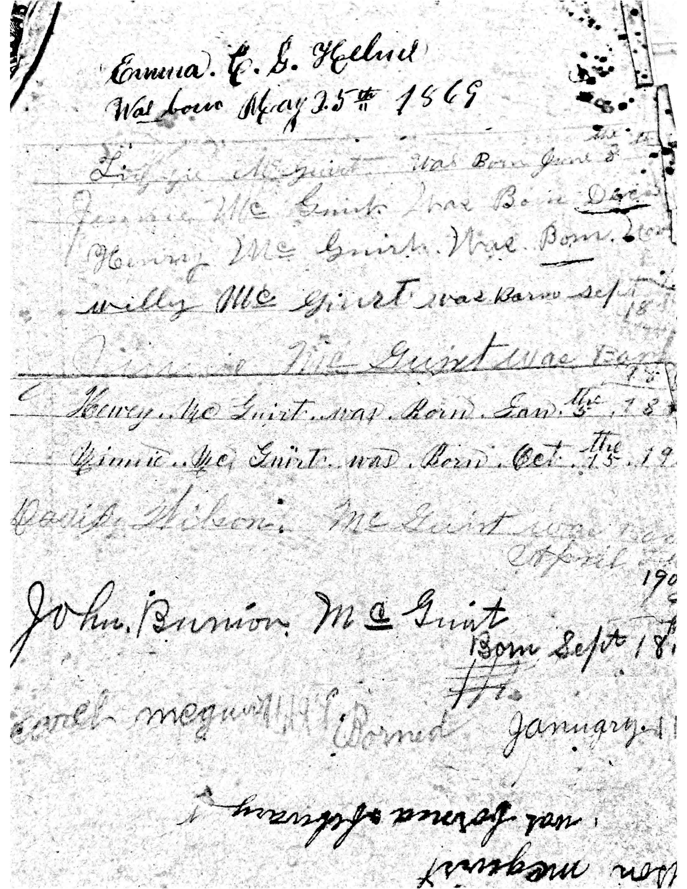
Family Bible 2
Pages from Will McGuirt’s family bible record his birth

Slide 3
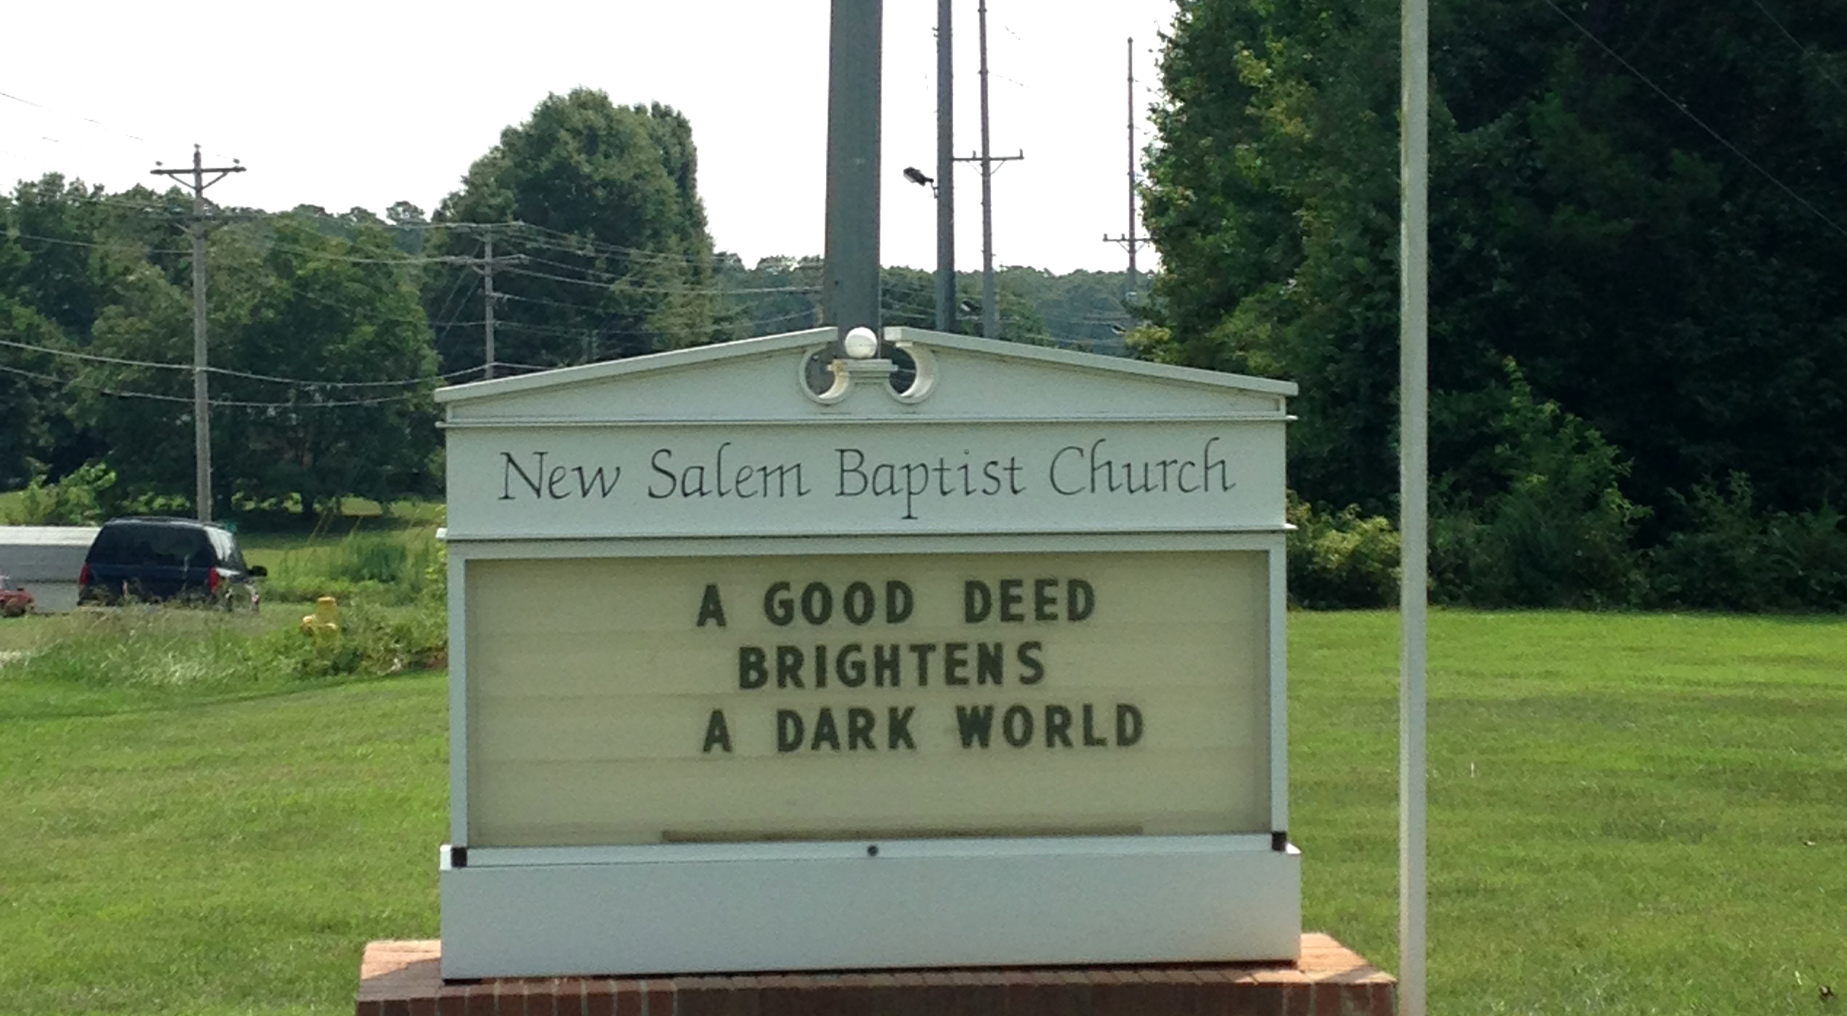
Will McGuirt’s church

Slide 4
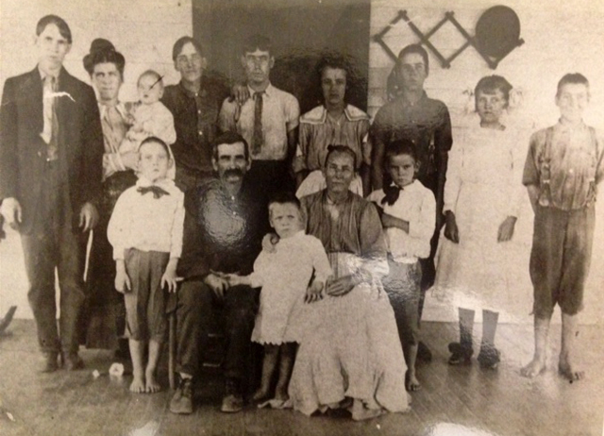
Will McGuirt’s Family

Slide 5
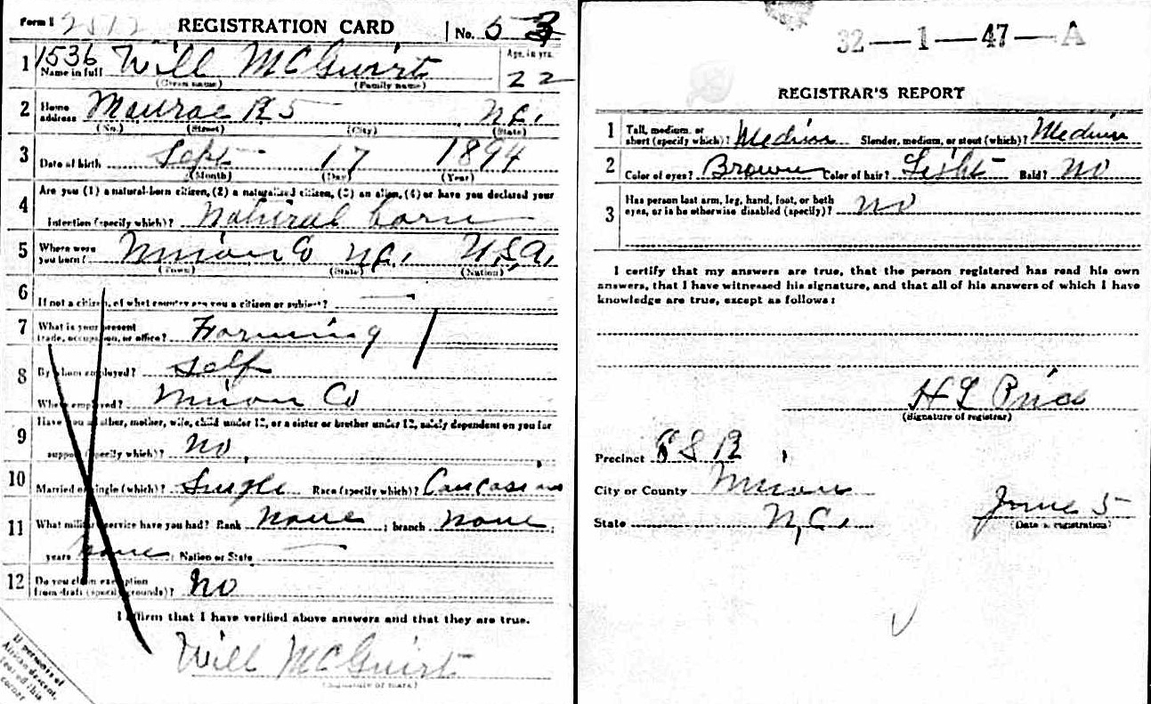
Will McGuirt’s World War I Registration Card

