Slide 1
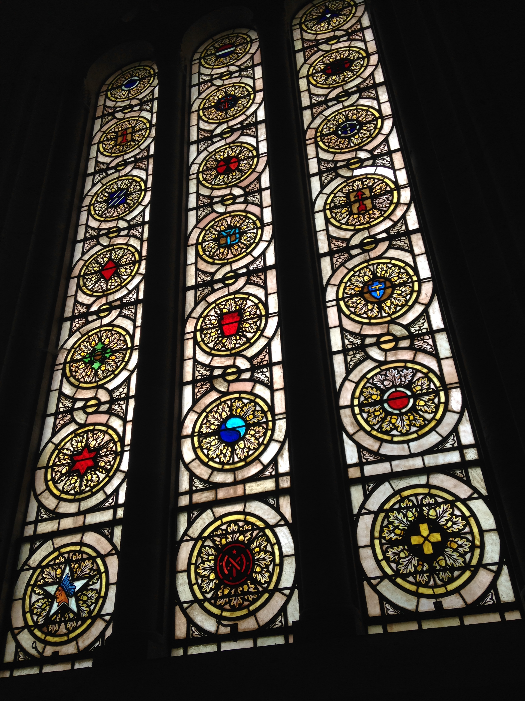
Stained glass windows at the Meuse-Argonne Cemetery chapel depicting insignia of the American units that participated in the Meuse-Argonne offensive. Photographer: Kate Harris.

Slide 2
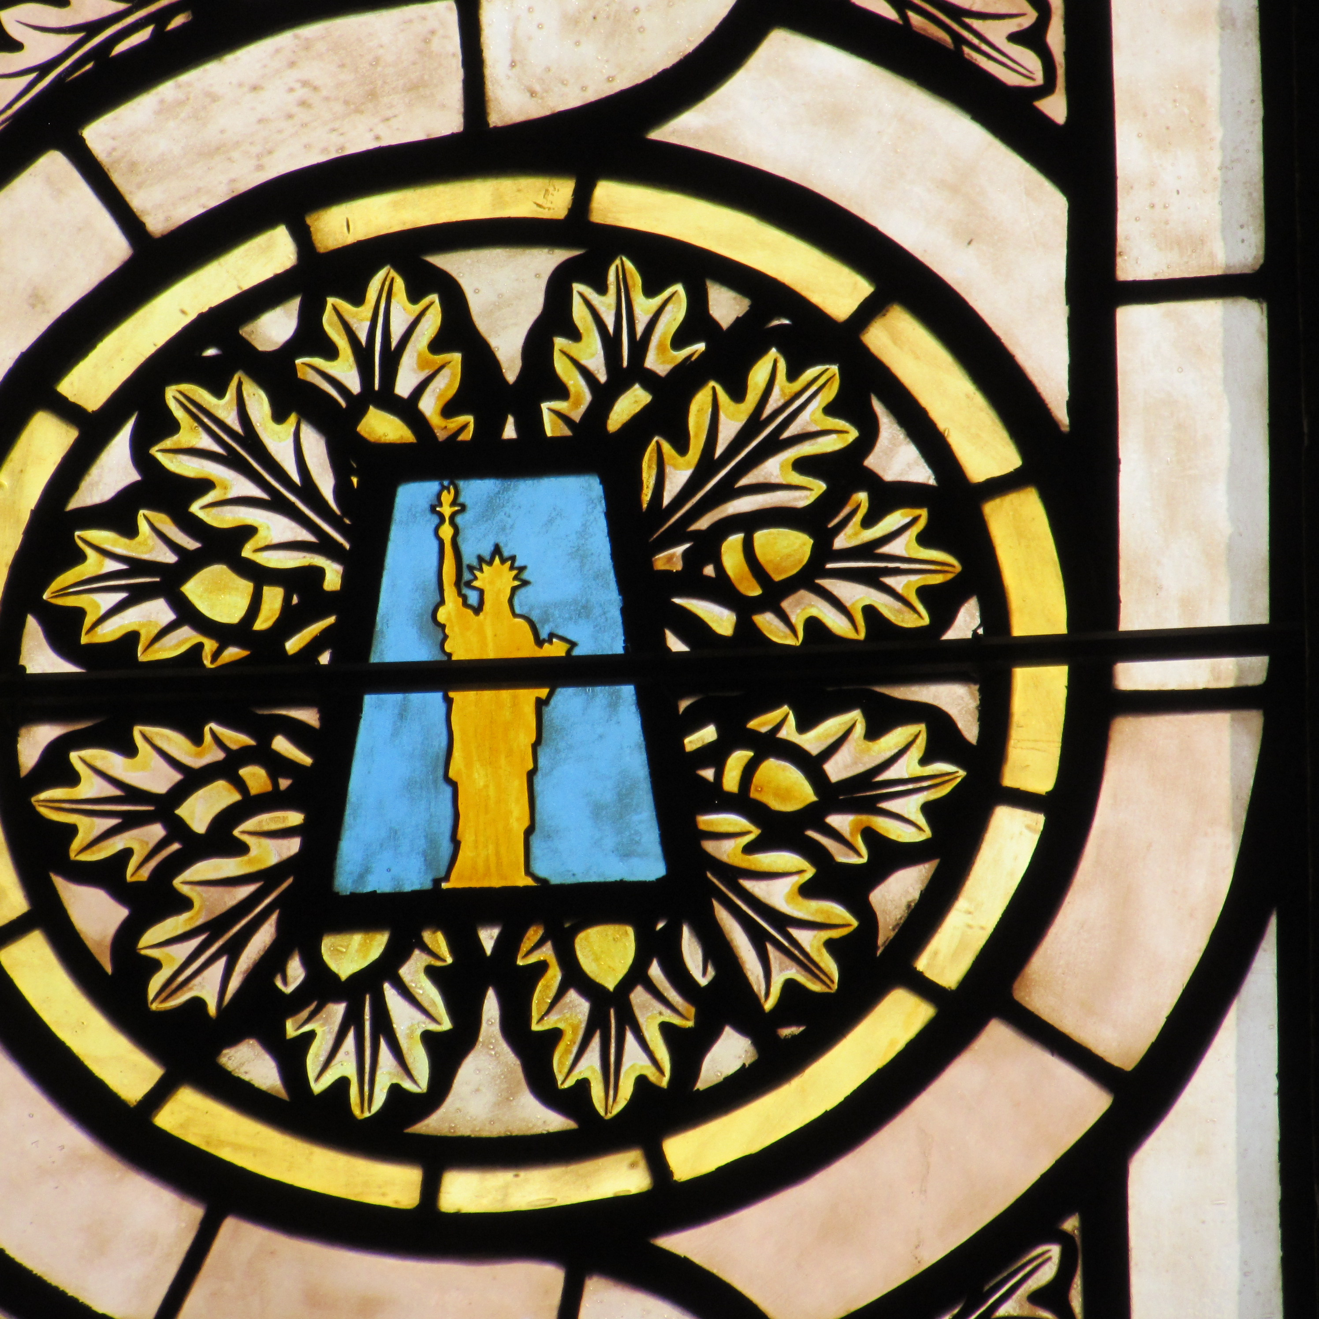
Stained glass windows at the Meuse-Argonne Cemetery chapel portraying insignia of the 77th infantry division based out of New York during World War I. Photographer: Lynn Rainville.

Slide 3
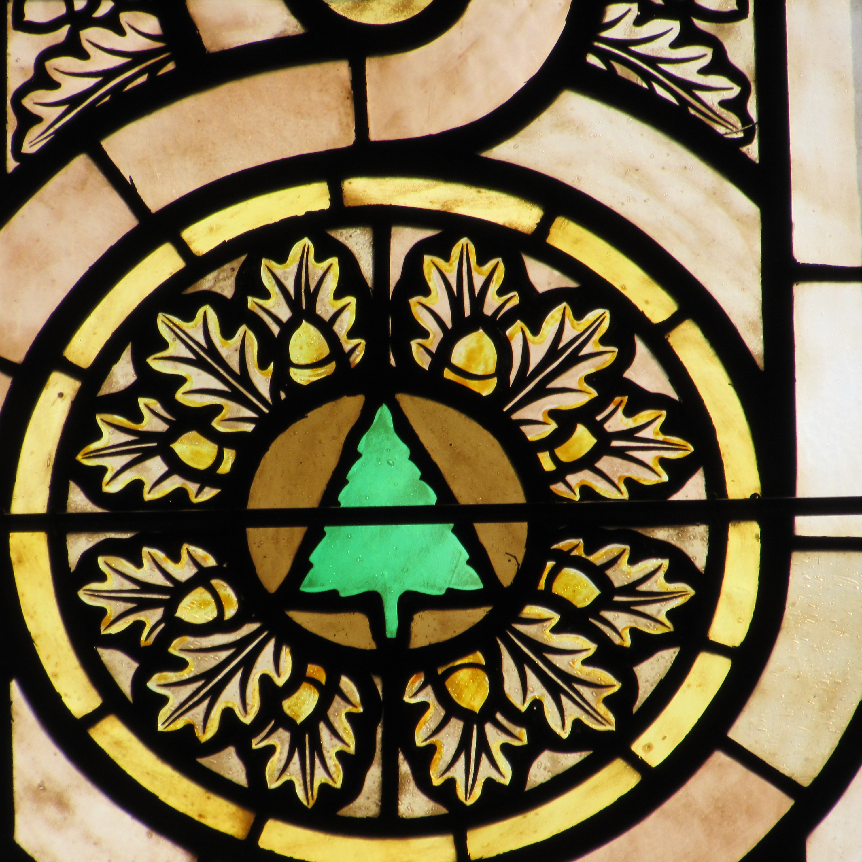
Stained glass windows at the Meuse-Argonne Cemetery chapel portraying insignia of the 91st infantry division based out of Washington during World War I. Photographer: Lynn Rainville.

Slide 4
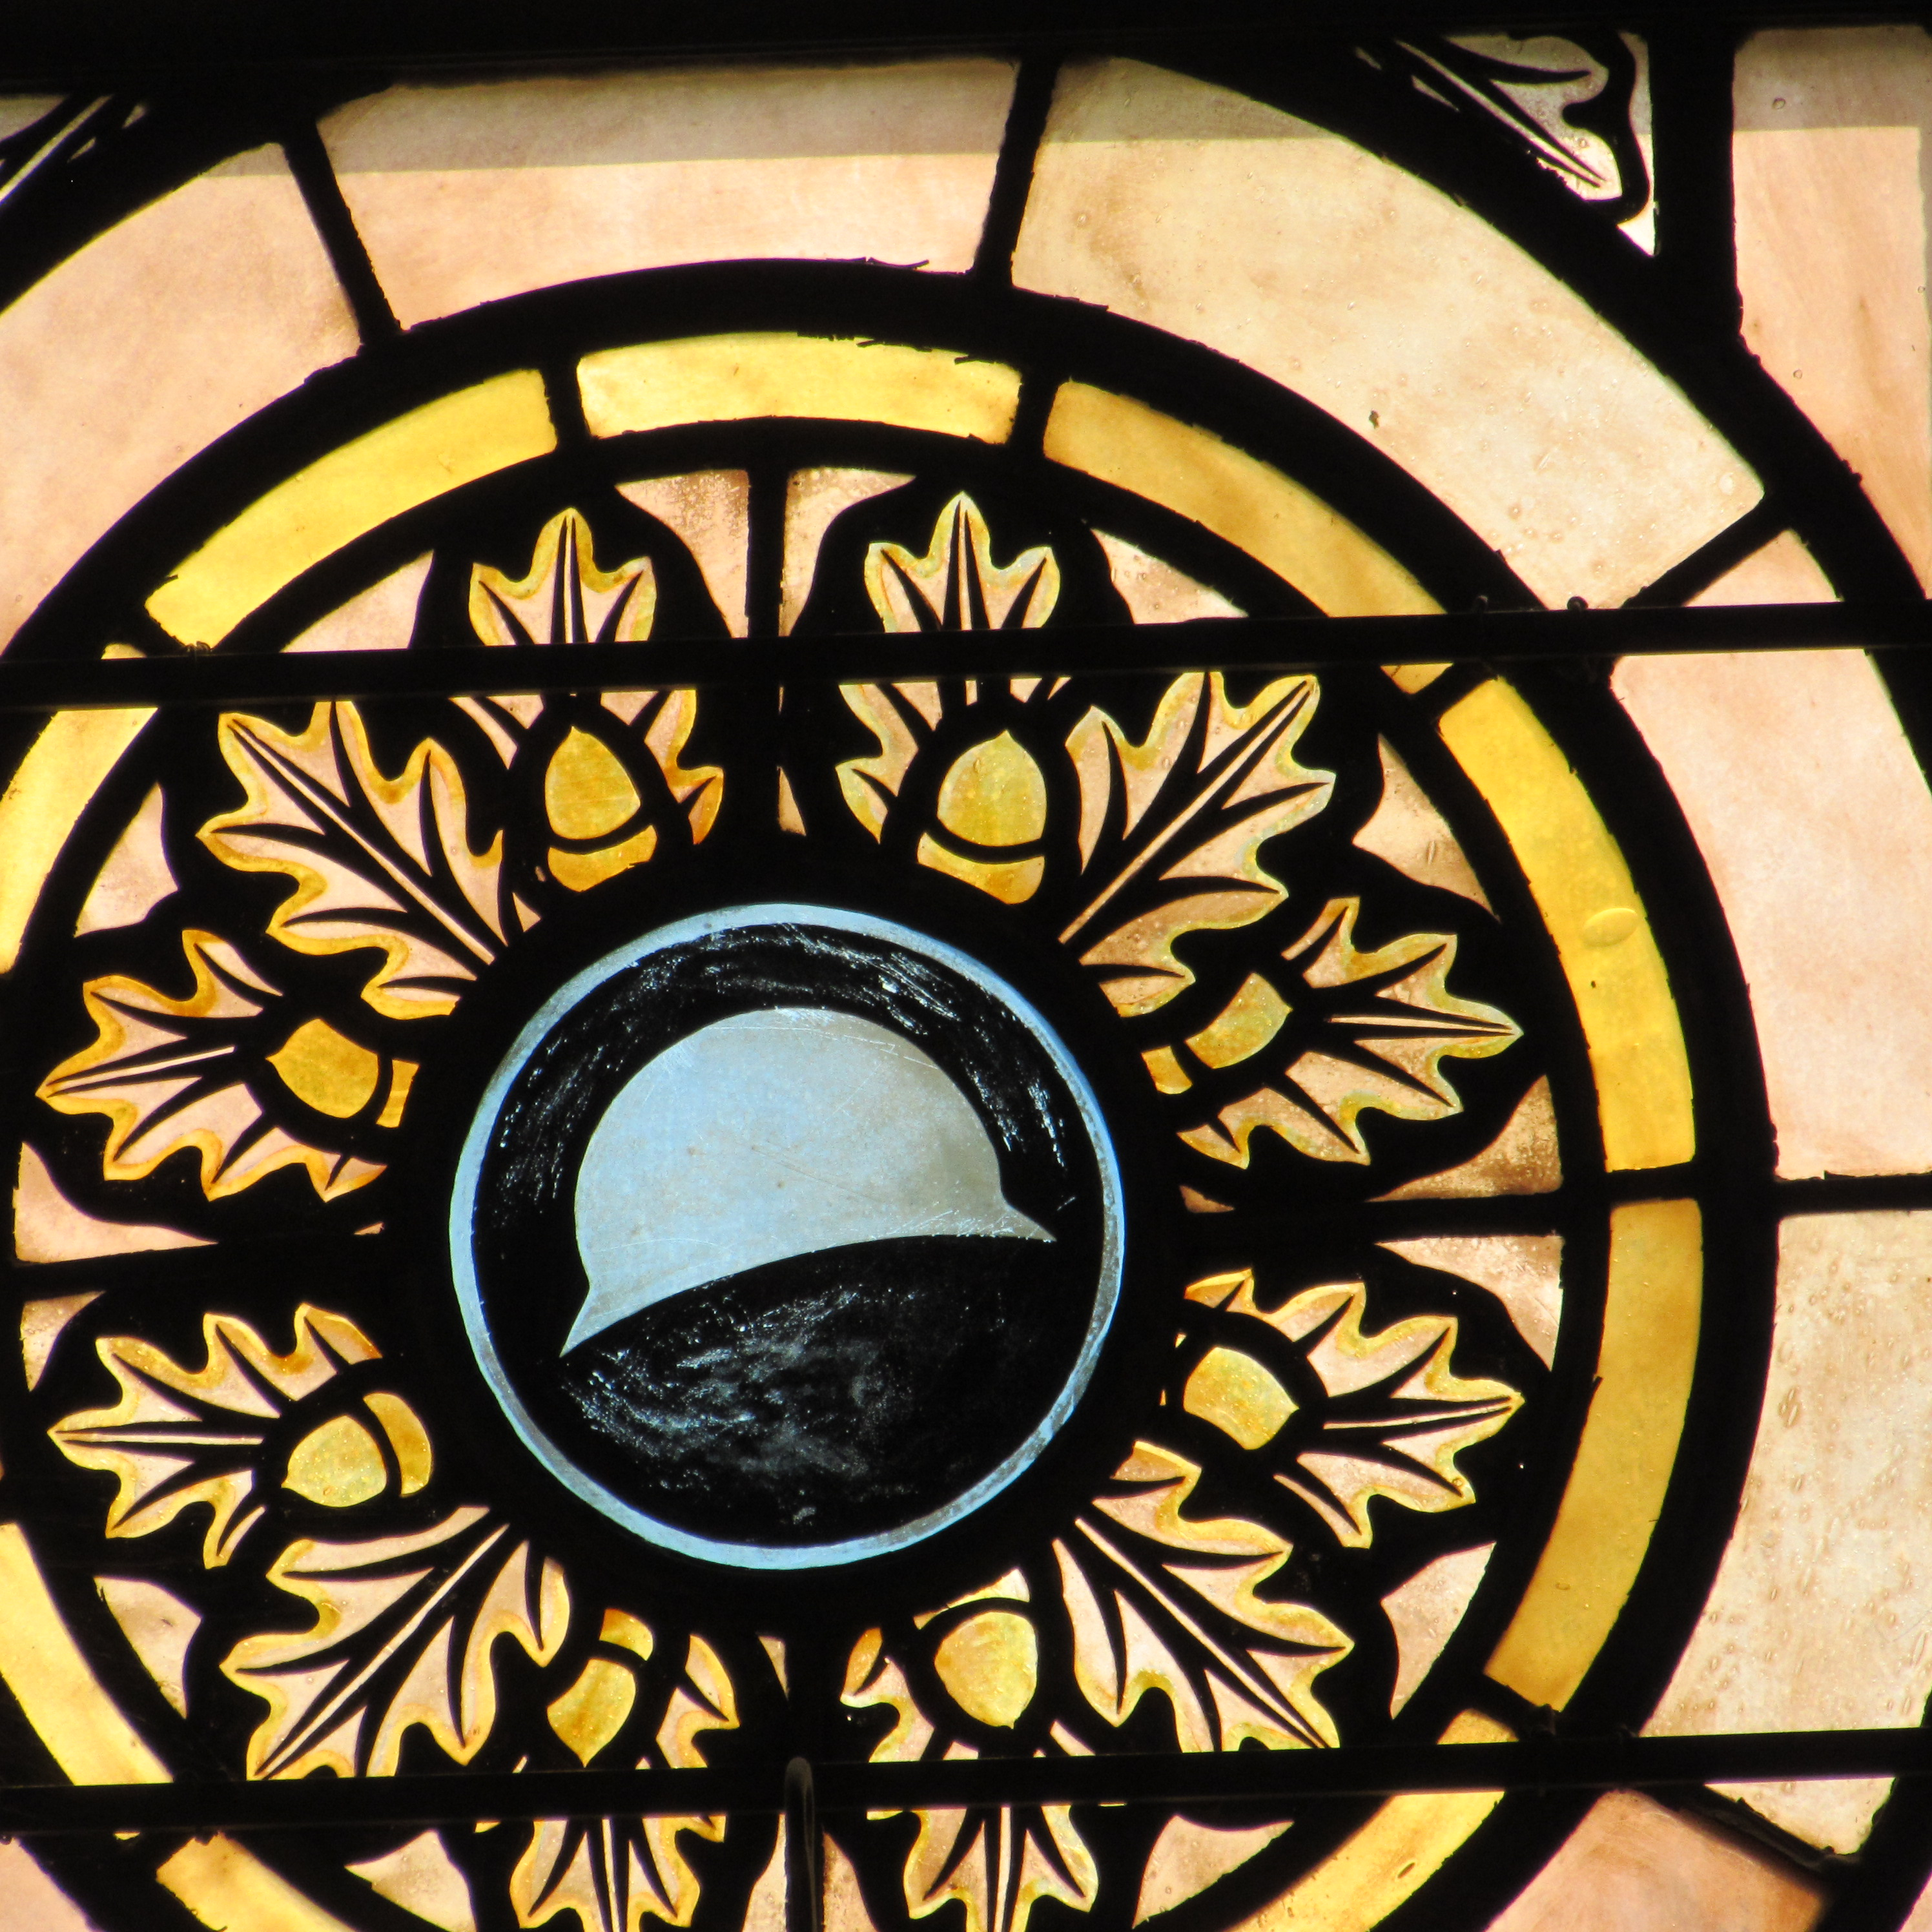
Stained glass windows at the Meuse-Argonne Cemetery chapel portraying insignia of the 93rd “colored” / segregated infantry division based out of Washington state. Photographer: Lynn Rainville.

