Slide 1
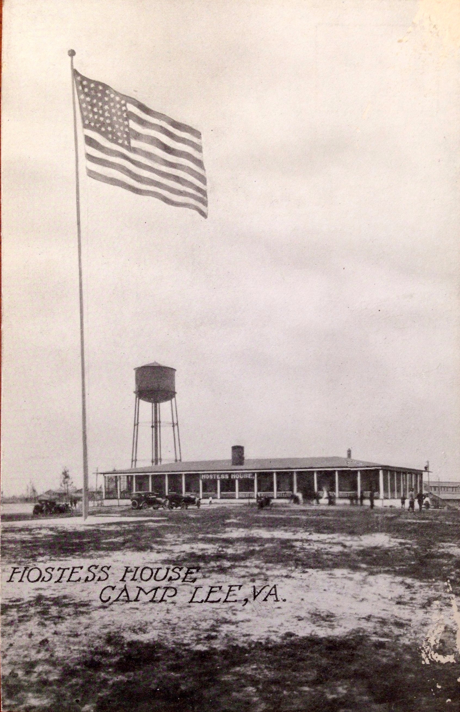
Notes:
The Hostess House at Camp Lee, Virginia.

Slide 2
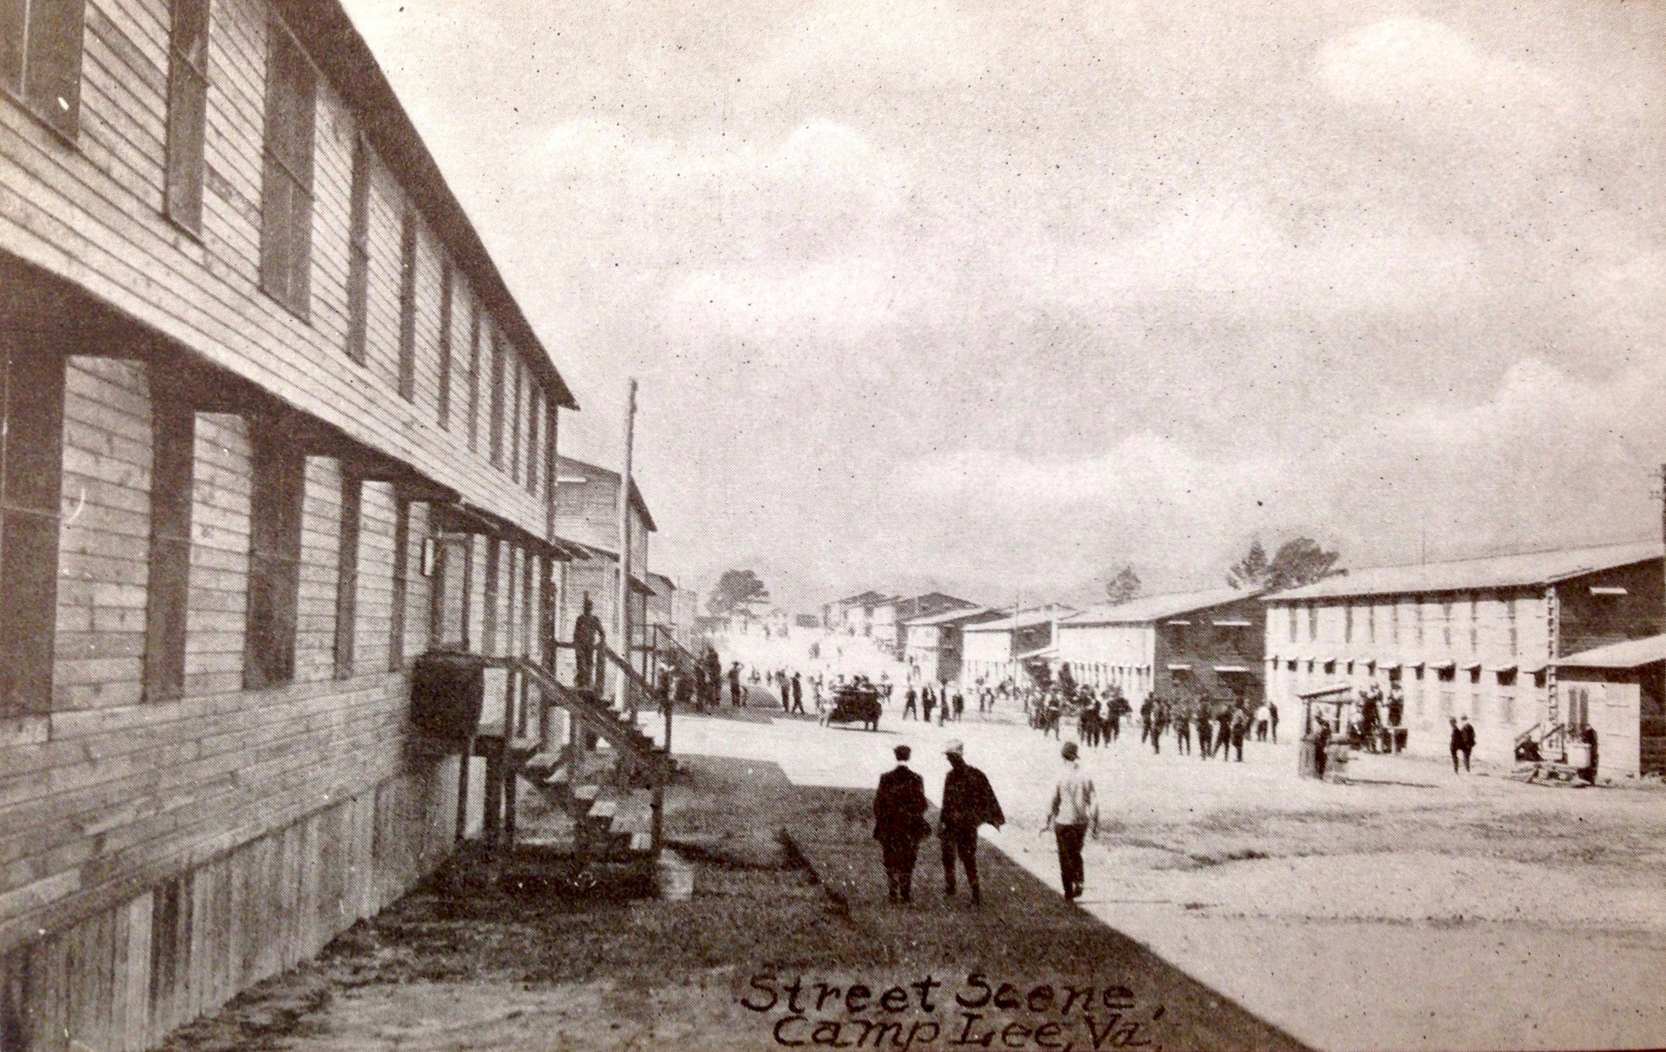
Notes:
Draftees walk along the street at the newly constructed Camp Lee.

Slide 3
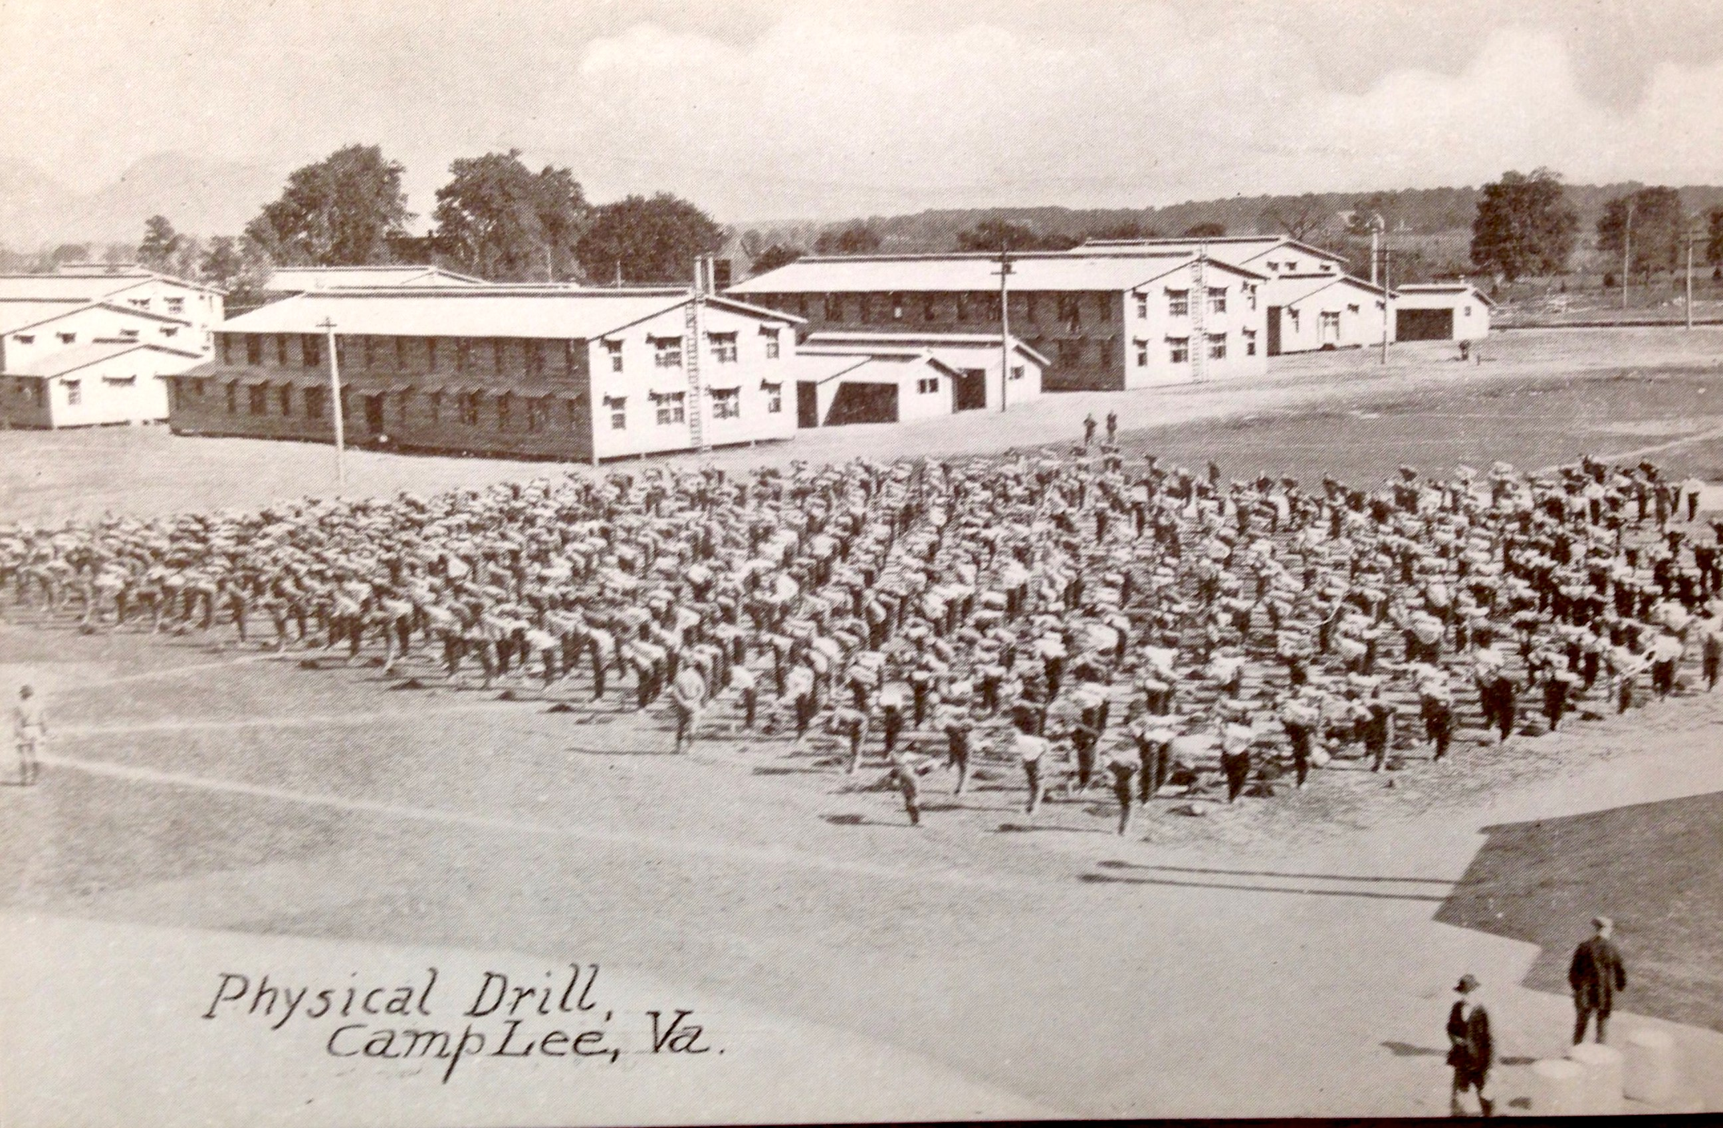
Notes:
Soldiers participate in early morning calisthenics at Camp Lee.

Slide 4
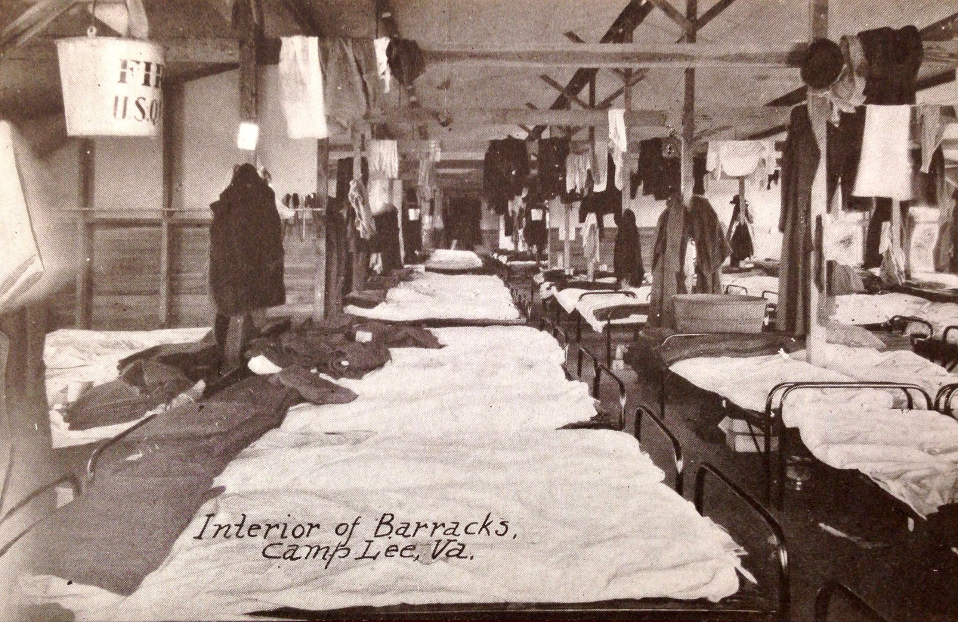
Notes:
The interior of the soldier’s barracks at Camp Lee.

Slide 5
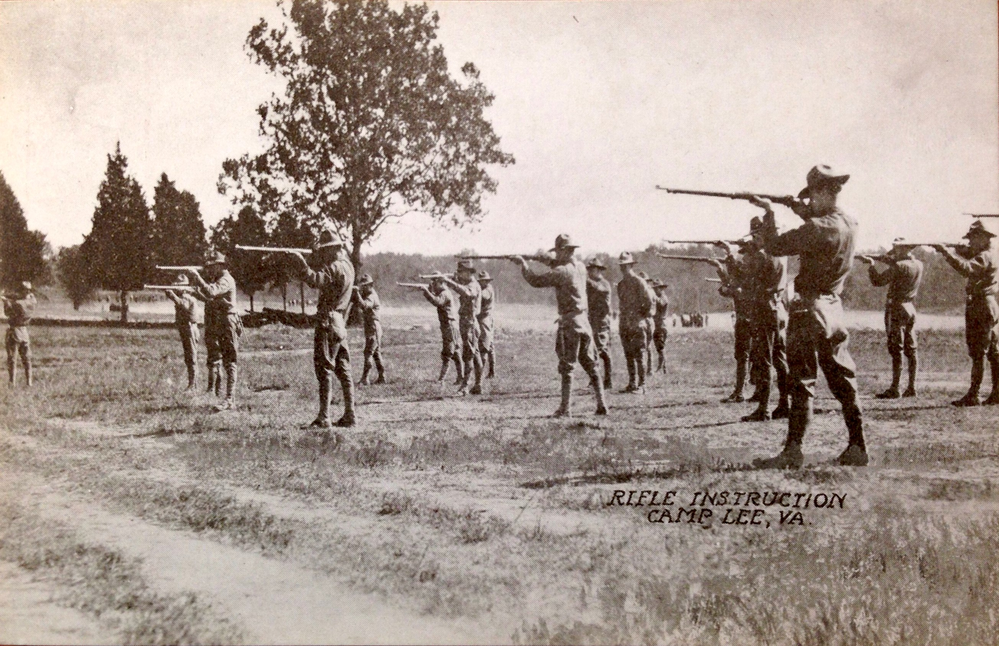
Notes:
Soldiers take rifle instruction at Camp Lee.

Slide 6
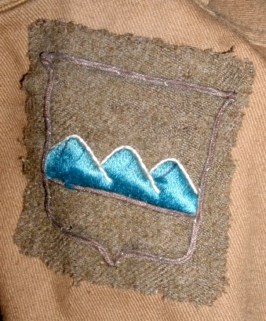
Notes:
As a matter of divisional pride, soldiers in the “Blue Ridge” Division attached patches to the shoulder of their uniform.

Slide 7
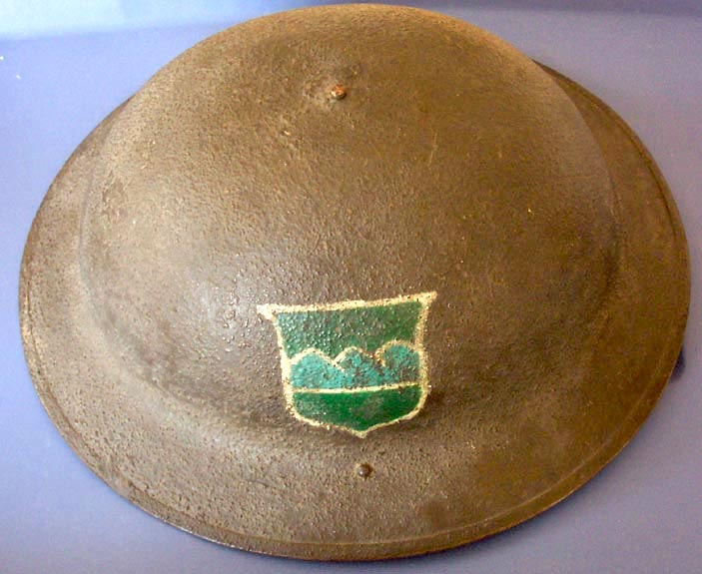
Notes:
Here the divisional insignia was painted on a soldier’s helmet.

