Slide 1
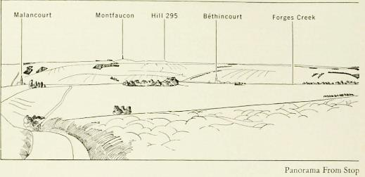
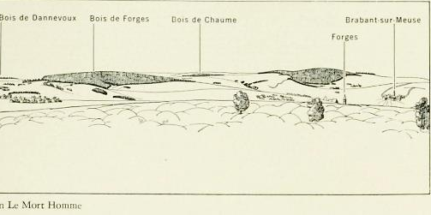
Notes:
This panorama, found on pages 196-197 of the Blue Book, is intended to show tourists the scene of the fighting in September 1918. “This area at that time was a scene of indescribable desolation. Thousands of shells had churned up the surface of the ground and the autumn rains had made it a sea of mud, littered with battlefield wreckage. Innumerable bands of barbed wire zigzagged their way across the hills and valleys, while the few shattered trees that remained stood lonely sentinels over the bleak landscape. Nature has done much to heal this battle-scarred area but even now (1937) the marks of trenches and shell holes are plainly visible” (Blue Book 196).

Slide 2
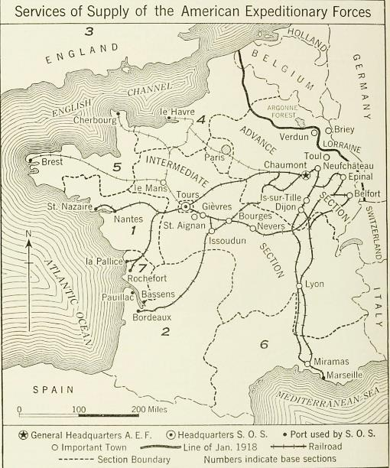
Notes:
This map shows how supplies and communications entering France from the coast south of Brest might travel towards the front using the railroad lines. It also shows how administratively the area was divided into base sections. (p. 438 in the Blue Book).

Slide 3
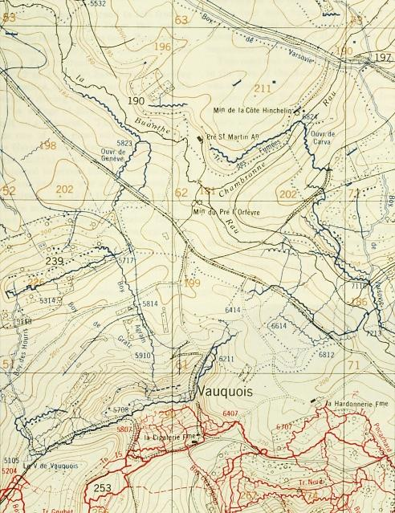
Notes:
This is a section of a war map showing the Trench system near Vauquois, insert on page 221 of Blue Book. “This type of map was the one generally used by American front-line units during the war” (Blue Book 220).

Slide 4
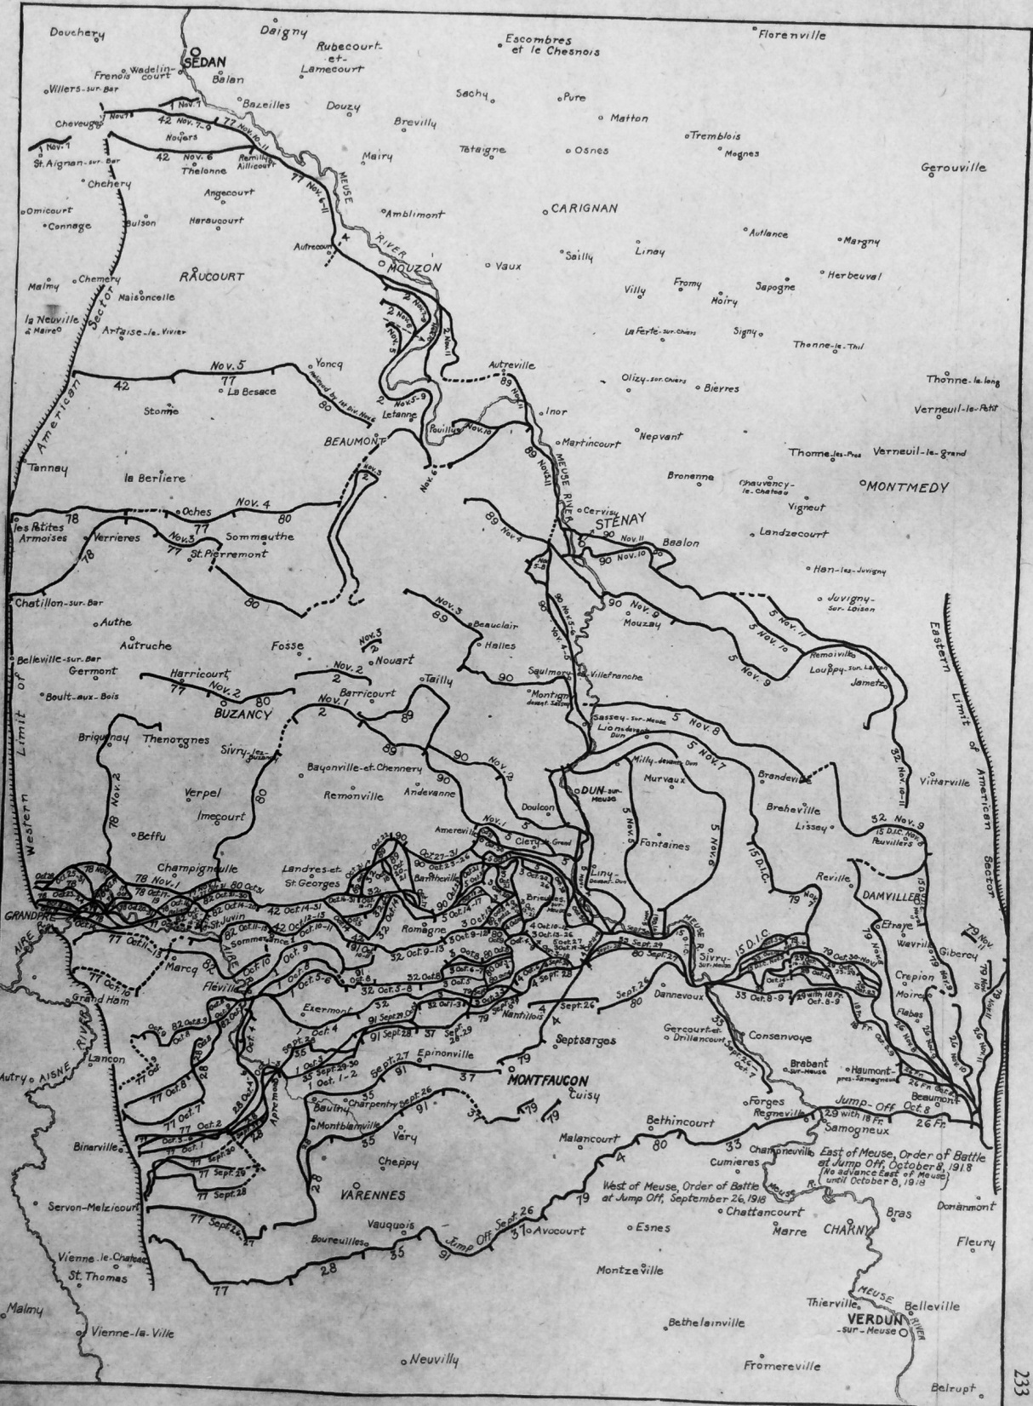
Notes:
This is a copy of the official map that was issued by the Intelligence Division of the General Staff of Headquarters of the AEF. It shows the daily advance, by divisions, from September 26-November 11, 1918.

Slide 5
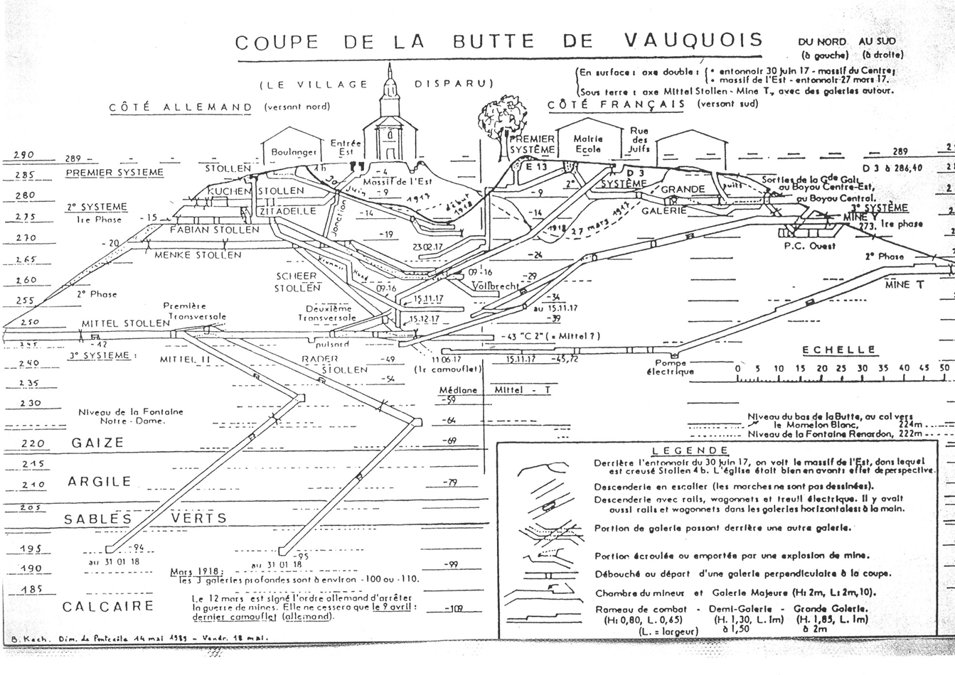
Notes:
This map shows the trench and tunnel system underneath Vauquois Hill. It reveals both the French and German sides.

Slide 6
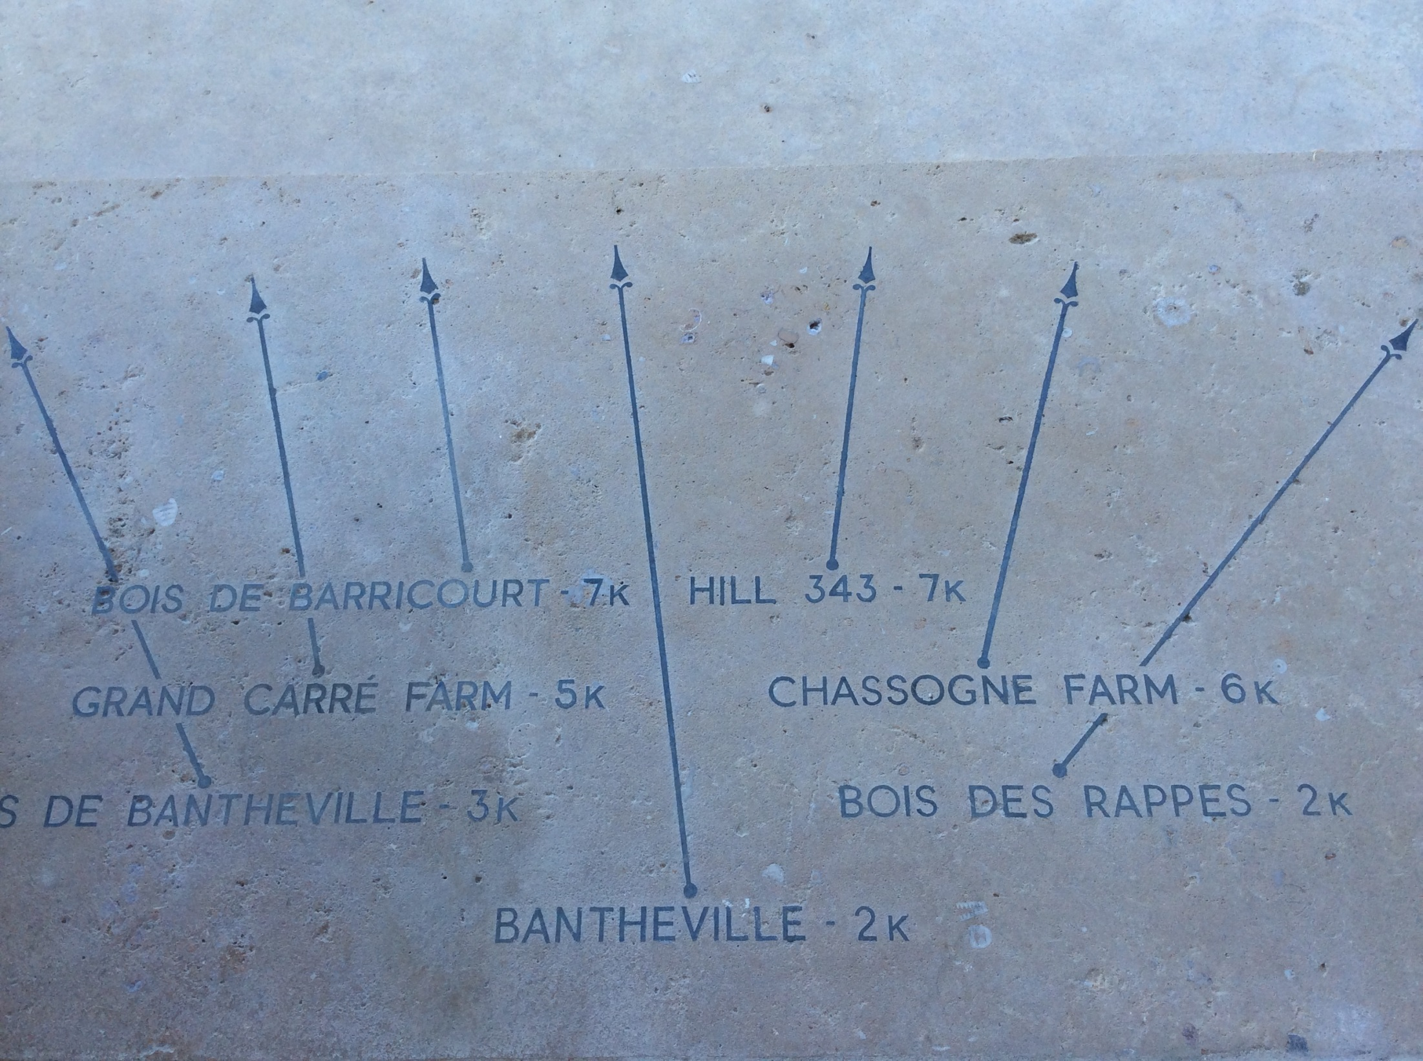
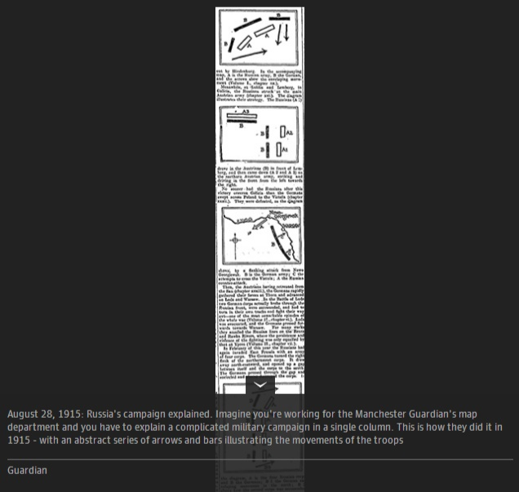
Notes:
This is a map showing direction from the top of the Montfaucon monument, aimed at tourists visiting war memorial sites in France.

Slide 7
Newscast Assignment
Working with a partner, choose ONE of the maps that we looked at in class today.
Create a 2-minute script that explains the significance of this map to a general audience. Be sure to include:
  The approximate date or time period that the map is from.
  The reason why the area shown is of importance.
  Any movement or changes that are being described on the map.
Keep in mind:
  Your map will be on display in the background as you present your script. What are two or three points that you would point out to your audience?
  You can format your newscast as a monologue (single-person speaking, interview, or conversation between two newscasters. Be creative!

