Slide 1
Grass
Carl Sandburg (1918)
Pile the bodies high at Austerlitz and Waterloo. Shovel them under and let me work— I am the grass; I cover all. And pile them high at Gettysburg And pile them high at Ypres and Verdun. Shovel them under and let me work. Two years, ten years, and passengers ask the conductor: What place is this? Where are we now? I am the grass. Let me work.
Notes:
This poem, by American poet Carl Sandburg, illustrates the experience of American deaths in wartime. What emotions are evoked in this poem? What specifics can be learned about World War I (note that Ypres and Verdun were major battles of WWI)? How does it help us learn about WWI? What is missing?

Slide 2
Video of the Meuse-Argonne moving images
Notes:
This is a video of the Meuse-Argonne cemetery, where Americans who lost their lives during the Meuse-Argonne offensive are buried. What does this visual suggest about America’s contribution to the war? What does it suggest about our national feelings about the war?

Slide 3
Nations engaged in the war 1914-1918 | Battle deaths
Russia | 1,700,000
Germany | 1,600,000
France | 1,385,800
Great Britain | 900,000
Austria | 900,000
Italy | 364,000
Turkey | 250,000
Serbia and Montenegro | 125,000
Belgium | 102,000
Bulgaria | 100,000
Romania | 100,000
United States | 50,300
Greece | 7,000
Portugal | 2,000
Total | 7,485,600
Notes:
Statistical table also sourced from The War with Germany A Statistical Summary. What questions might this provoke with students? We often state that tables of statistics are useful because they are more accurate, but students might point out that these are clearly estimations (all numbers ending in nice round zeroes). Why is that? What is gained or lost from that?

Slide 4
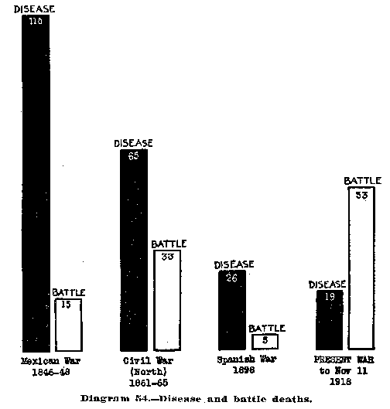
Notes:
This graph from The War with Germany A Statistical Summary visualizes the number of deaths from disease and battle from four American wars. While it allows students to see the trend over time (fewer deaths from disease, more deaths from battle by the time of WWI), it uses an index of numbers (these are deaths per 1,000 soldiers) that can distort the vast number of soldiers killed.

