Slide 1
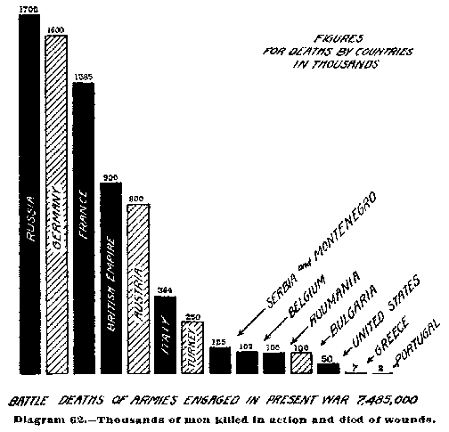
Notes:
A bar graph is useful when we are comparing across categories. Ex: How many battle deaths were there from each nation during WWI?

Slide 2

Notes:
A great way to illustrate this is by using Polleverywhere as a quick classroom activity. Set up a question for your students to answer from a set of multiple choice answers. A bar graph will appear on the screen as students answer, revealing how many people agree with each choice. There is a link to a video explaining it, here: http://vimeo.com/37674303).

Slide 3
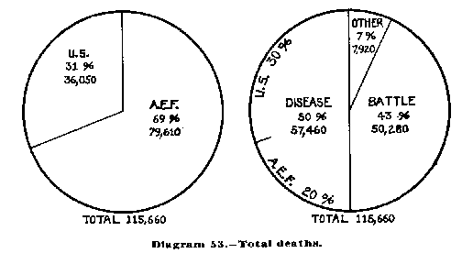
Notes:
Pie graphs are useful when comparing categories but only when the numbers reflect a percentage of a whole. In this example, the chart on the left shows how many American deaths were from the American Expeditionary Force vs. the National Army. On the right side, it explains whether these deaths occurred as a result of battle or disease.

Slide 4
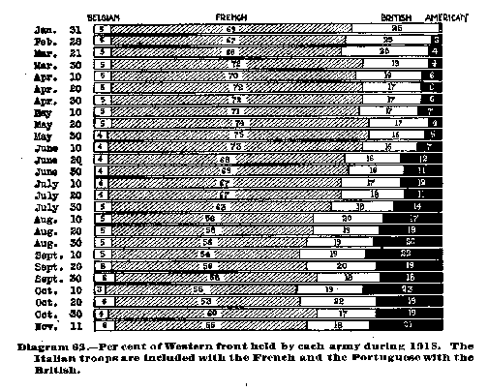
Notes:
This is different take on the same idea. These graphs also show percentages but in a block format. This complicated graph also shows change over time. What trend becomes apparent here?

Slide 5
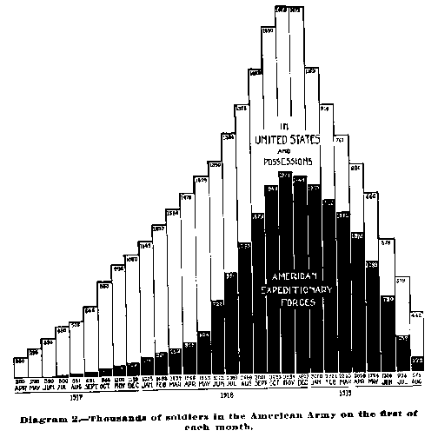
Notes:
This is graph is technically a bar graph, but it is set up to show change over time. We more commonly show that in a line graph, as seen on the next slide. It’s the exact same information, just visualized slightly differently.

Slide 6

Notes:
Here’s a modern version of that last graph. It makes it slightly easier to see the change happening over time, and takes out the data about which part of the United States military force these soldiers were apart of. This graph helps us easily answer the question, “When was the American military at its peak size during the war?”

