Slide 1
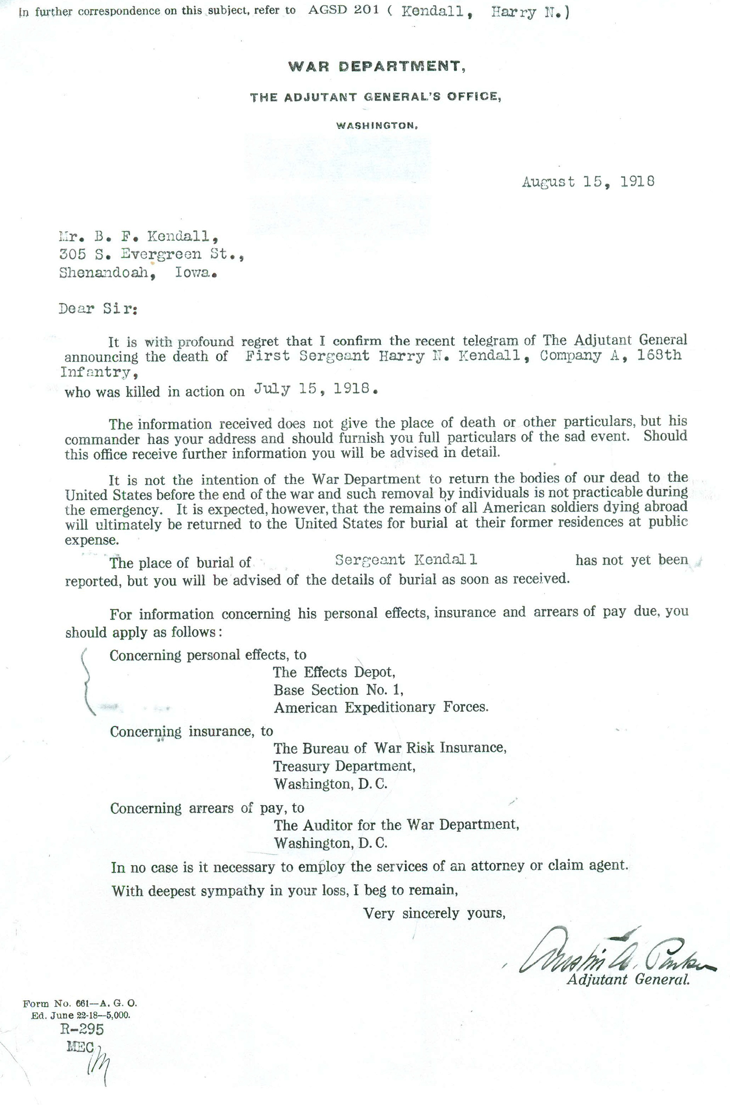
War Department letter notifying the family of the death of Harry N. Kendall. National World War One museum, Kansas City.

Slide 2
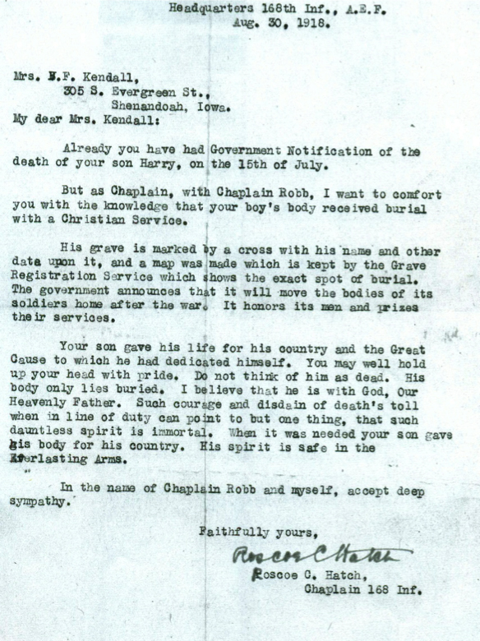
Chaplain’s letter to the family concerning Harry N. Kendall’s death and initial burial.

Slide 3
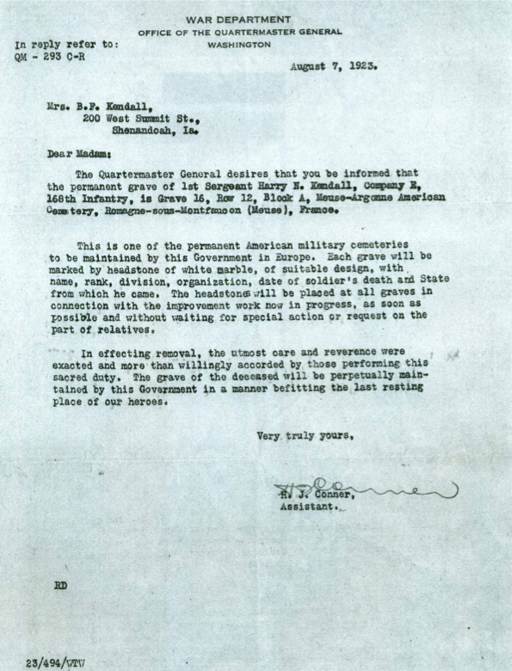
War Department letter describing the final resting place of Harry N. Kendall at the Meuse-Argonne cemetery. National World War One museum, Kansas City.

Slide 4
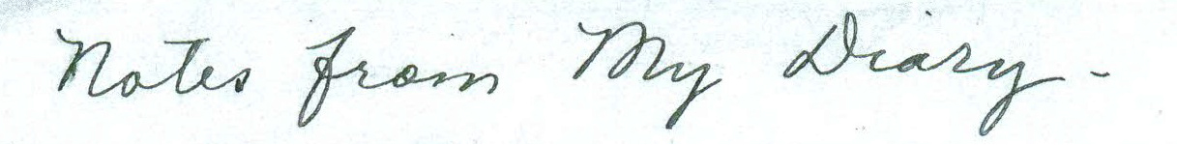
Diary entry heading of Mrs B.P. Kendall. National World War One museum, Kansas City.

Slide 5
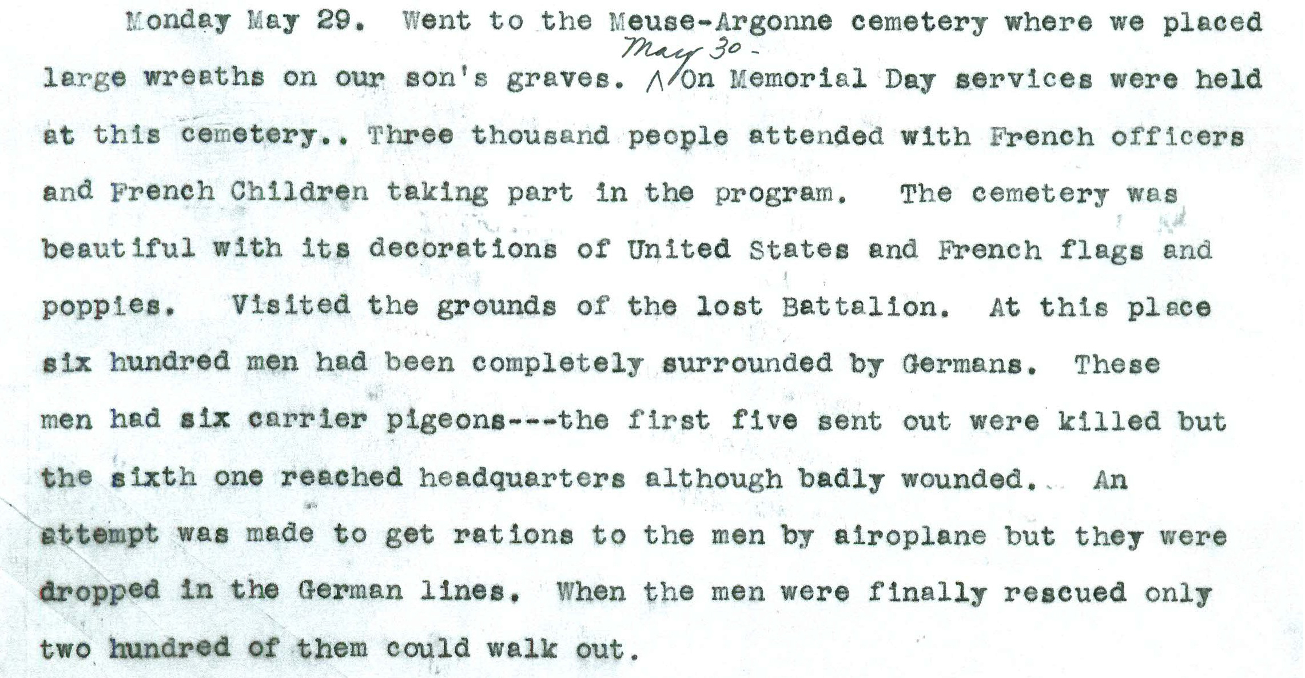
Diary entry of Mrs B.P. Kendall. National World War One museum, Kansas City.

Slide 6
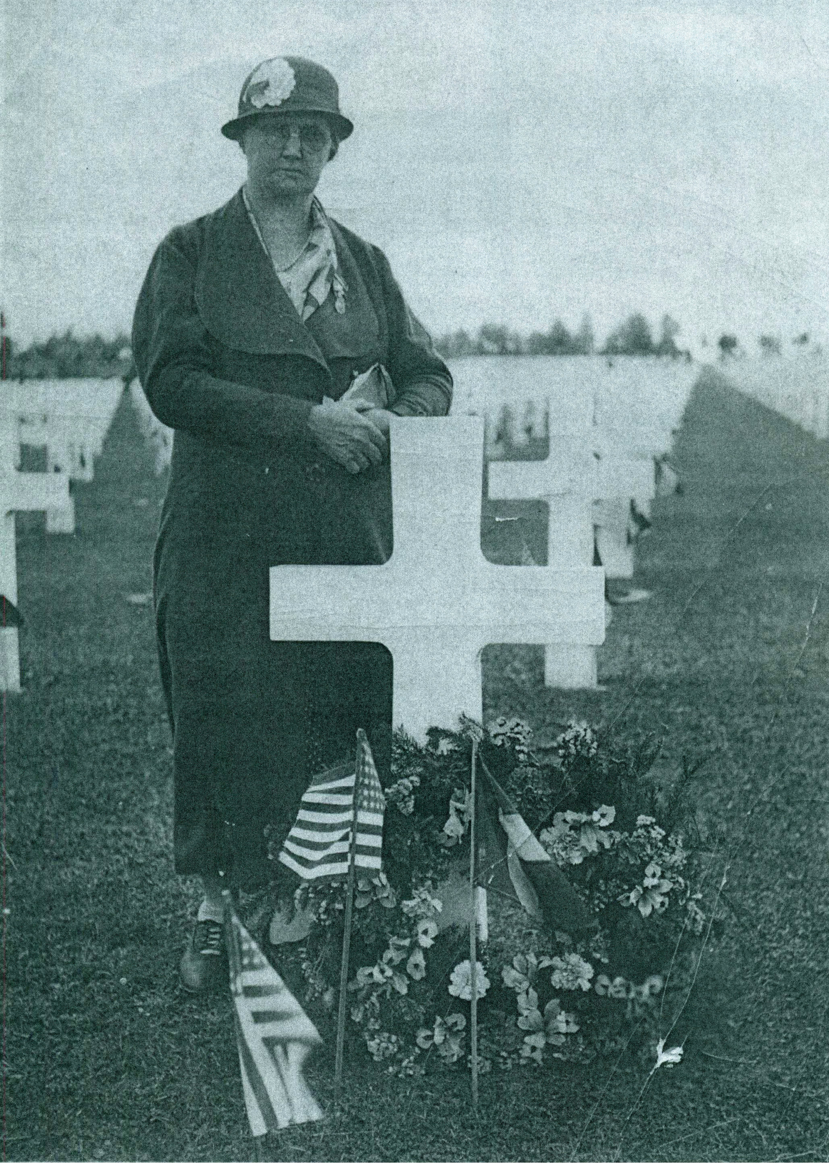
Picture of Mrs Kendall at her son’s grave in 1933. National World War One museum, Kansas City.

Slide 7
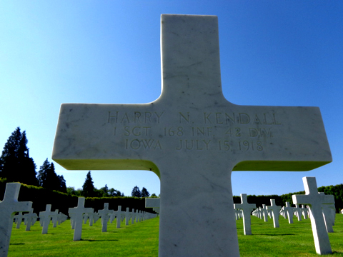
Harry N. Kendall’s grave today. Photographer: Colin Baker.

