Slide 1
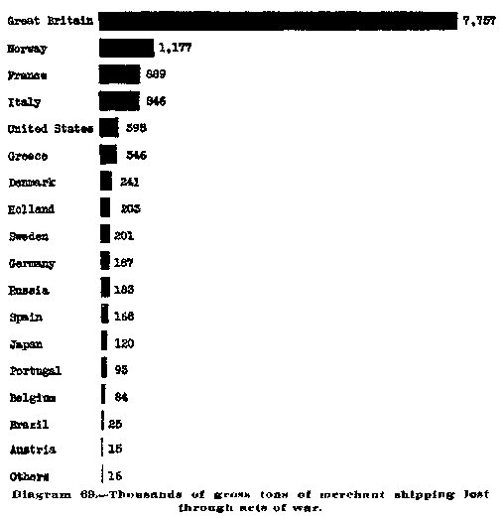
Think: What does this suggest about the United States’ reasons for entering the war? How might they compare to other countries’ reasons for involvement?
What aspect of WWI is this chart showing? Take a guess! When you click on this box the answer will be revealed.
Notes:
Talk about what clues might have led students to guess that this chart was about shipping. They may have known that Britain had a large navy, and that Germany didn’t really suffer from submarine losses.

Slide 2
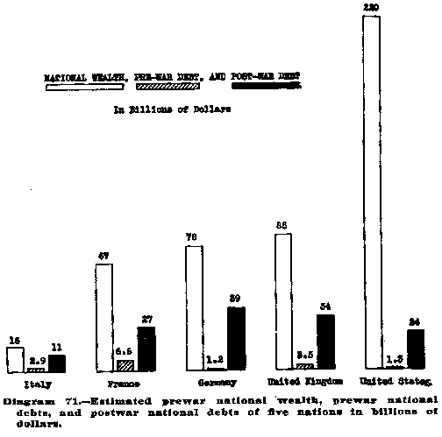
Look carefully at this chart showing the wealth of the primary nations involved in World War I.
The white bar shows total national wealth, before the war. The grey bar shows the estimated pre-war debt, and the black bar is post-war debt, measured in billions of dollars.
Based on what you have learned, how do you think the bars for the United States will look? Write down your guesses and then click on this box!
Think: What does this suggest about the United States’ economy during and after the war? How did the war impact their economy? How did it impact the rest of Europe? Why do you think this is?
Notes:
By removing some of the information, you force students to think about what they have learned about the impact of the war. This can be an effective summative activity—while they are unlikely to guess the exact numbers, students would probably be able to guess that the United States would be in less national debt after the war relative to nations that had been fighting longer, and would probably have been in a period of great economic wealth (following the Gilded Age).

Slide 3
Using this same chart, think about how newspapers in 1919 might have written about this topic. What headlines would they have used?
Click this box to see some examples!
Allied Friends Low on Funds!
US Wealth Wins the War; Germany in Trouble.
France Says “Oui” to Debt; How Will they Repay Loans?
Notes:
Having students write newspaper headlines is an effective means of evaluating whether or not they get “the big picture.” The book Enlivening Secondary History suggests dividing the class into four mini-groups: “The Paris-based Express, the London-based Times, the Berlin-based Post, the New York Times,” and incorporate the nation’s perspective into the headlines that they would produce (92).
Another low-tech way to do this is to have them sum up what this graph is telling them on a sticky-note and posting it on the board near where the graph is displayed. That way they have to concisely express their thoughts in a way that can be shared with others as they head out of class they day or transition to your next activity.

