Slide 1
ABMC Blue Book Meuse-Argonne Maps - Chronology

Slide 2
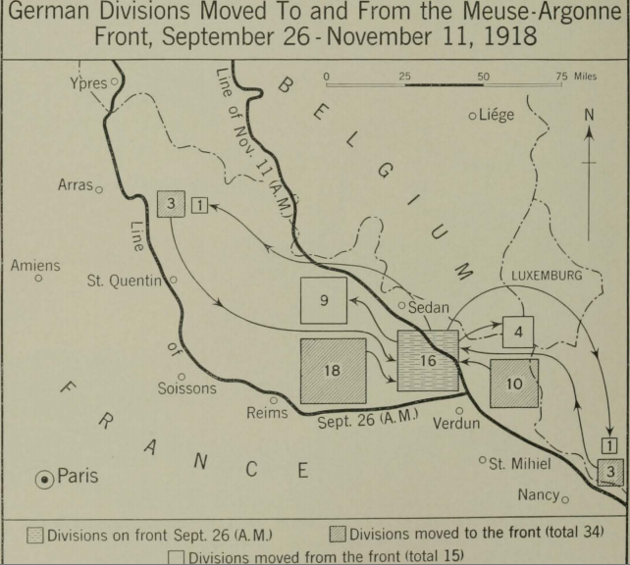

Slide 3
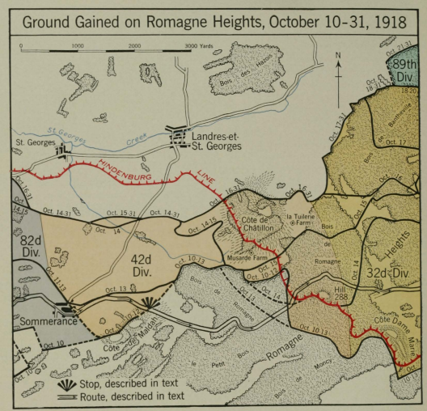

Slide 4
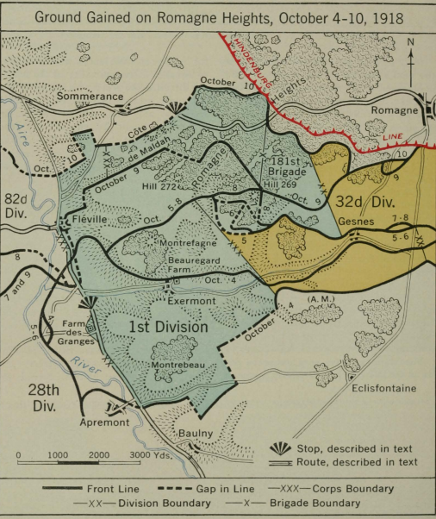
Notes:
ABMC Blue Book, p. 226.

Slide 5
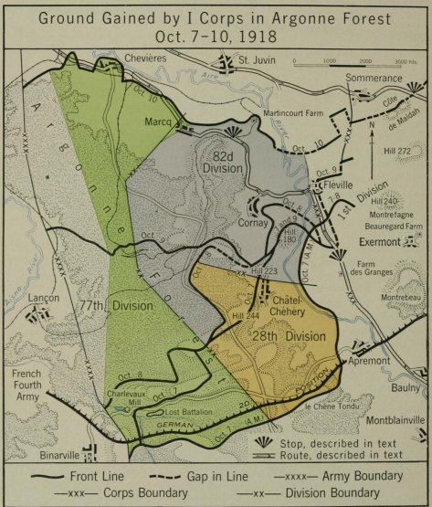
Notes:
ABMC Blue Book, p. 228.

Slide 6
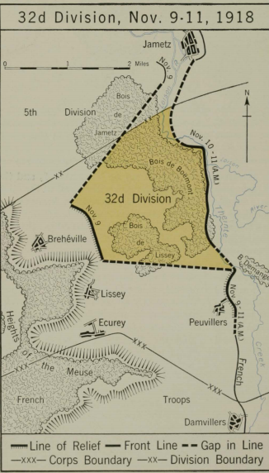

Slide 7
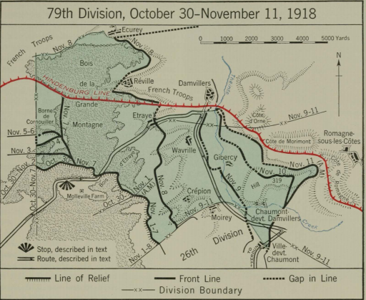
Notes:
ABMC Blue Book, p. 269.

Slide 8
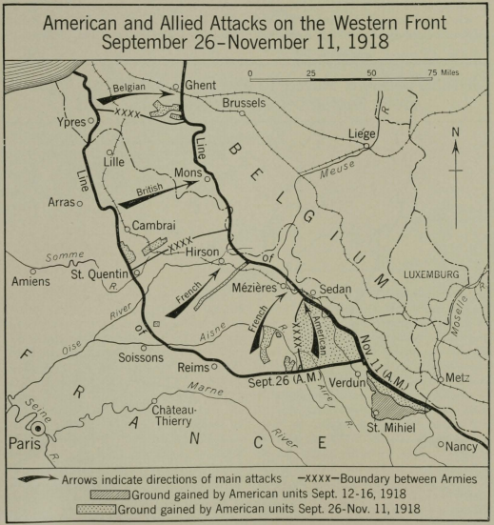
Notes:
ABMC Blue Book, p. 189.

Slide 9
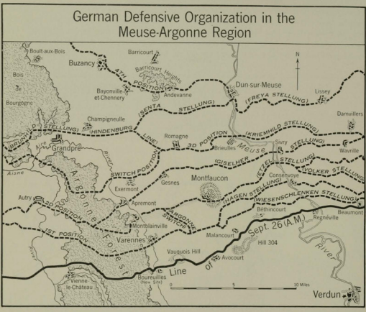
Notes:
ABMC Blue Book, p. 170.

Slide 10
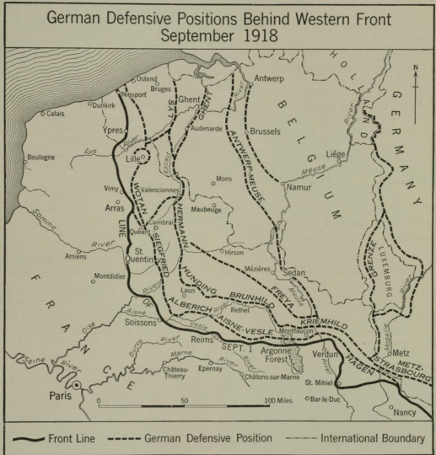
Notes:
ABMC Blue Book, p. 169.

Slide 11
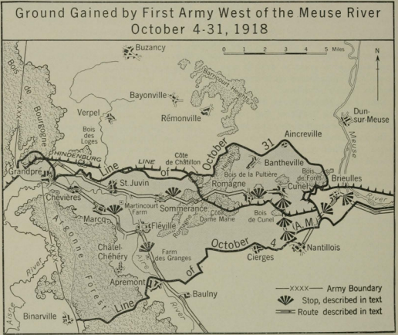
Notes:
ABMC Blue Book, p. 182.

Slide 12
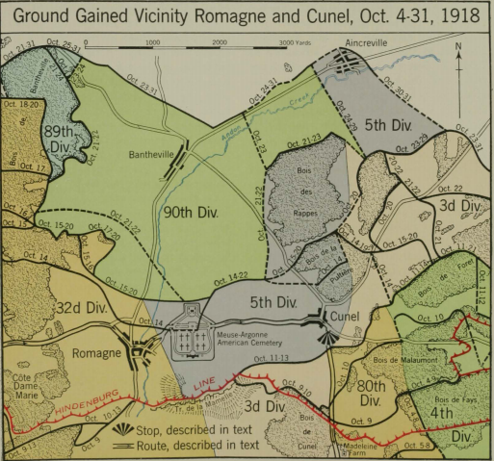
Notes:
ABMC Blue Book, p. 249.

Slide 13
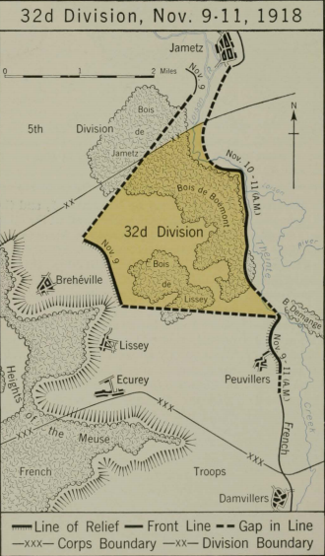
Notes:
ABMC Blue Book, p. 270.

Slide 14
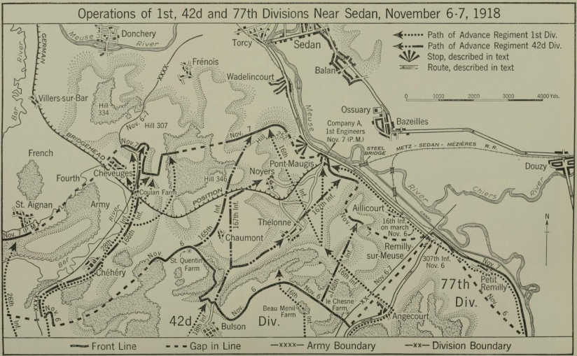
Notes:
ABMC Blue Book, p. 296.

Slide 15
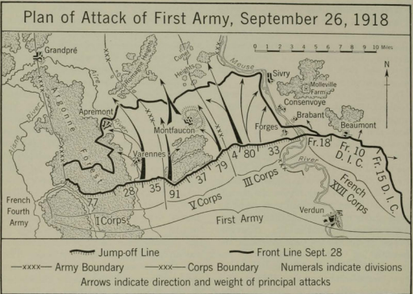
Notes:
ABMC Blue Book, p. 172.

