Slide 1
ABMC Blue Book
ABMC Meuse-Argonne Memorials and Monuments

Slide 2
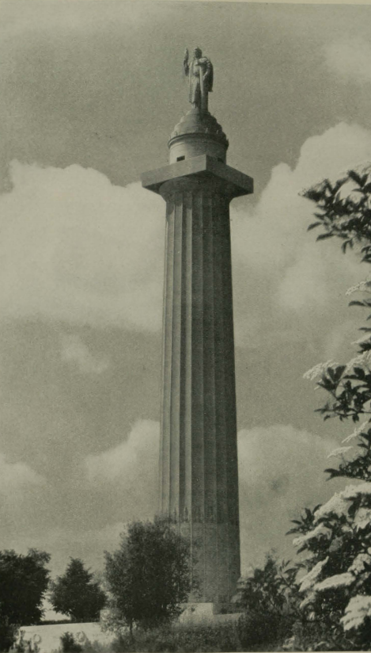
Notes:
The Meuse-Argonne American Memorial at Montfaucon – the shaft is 180 feet high.

Slide 3
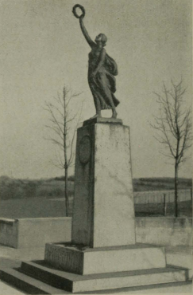
Notes:
Missouri Monument Near Cheppy

Slide 4
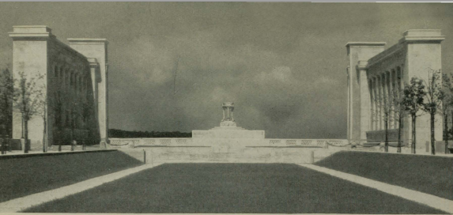
Notes:
Pennsylvania Memorial at Varennes, 1927

