Slide 1
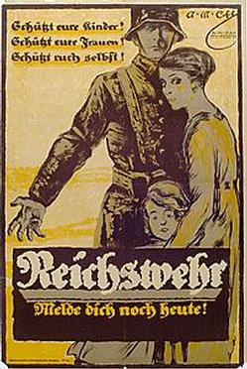
“Protect your children! Protect your women! Protect yourself! Join Reichswehr today!” “Protect Your Children!..” Armchairgeneral.com. Web. July 30, 2014 http://www.armchairgeneral.com/forums/showthread.php?t=103329&page=75

Slide 2
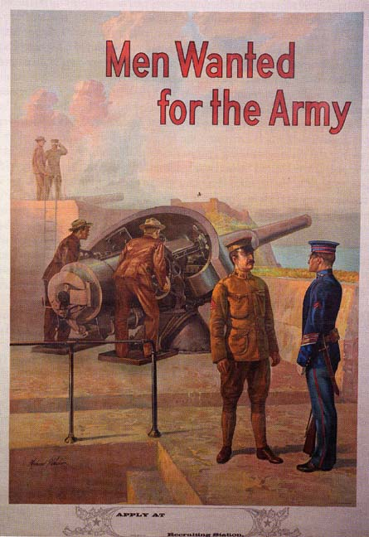
Michael P. Whelan, “Men Wanted for the U.S. Army (Coastal Artillery), 1909” in Richard Stewart, ed, “The United States Army in a Global Era, 1917-2003,” American Military History, Vol. II (Washington, DC: Center of Military History United States Army, 2005) http://www.history.army.mil/books/AMH-V2/AMH%20V2/chapter1.htm#b9

